Slide 1
Update Belgium
Dany Bylemans
Eufrin board 15/11/17 Brussels

Slide 2
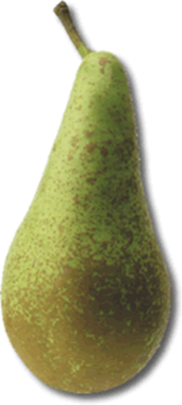
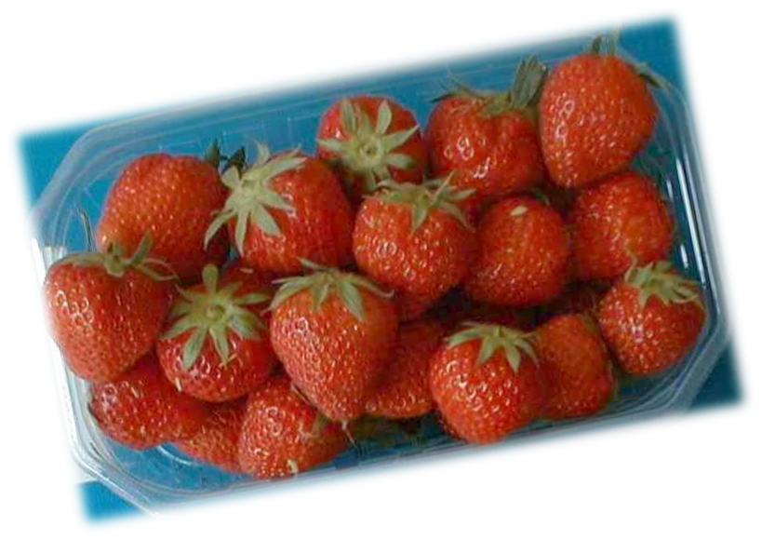
Fruit | trend
apple
pear
Strawberry
Raspberry, blackberry
Blueberry
Red currant
Cherry
viticulture
Pome fruit crisis:
2011: storm
2014: Russia ban
2016: hail
2017: frost (apple:-70%)

Slide 3
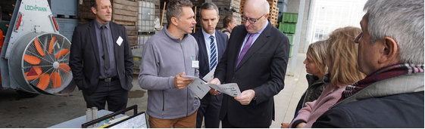
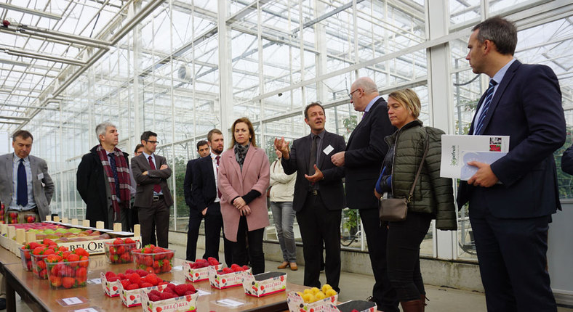
Visit EU commisioner Hogan 23/10/17
How is EU money spent?
How is continuity foreseen after the project?
How does the message reach the farmer?
We explained the role of Eufrin and the various WG’s
We emphasized the importance of projects like Eufruit

Slide 4
Scientific Prize Professor Soenen
Step taken:
International candidates
Next step:
International jury?

Slide 5
