Slide 1
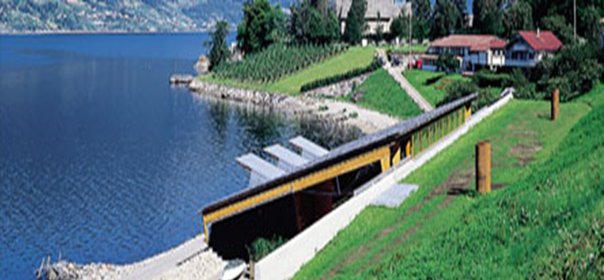
Country report- Norway EUFRIN BOARD MEETING - Nov. 15, 2017
Professor dr. Mekjell Meland
Nibio Ullensvang
Norwegian Institute of Bioeconomy Research
www.nibio.no

Slide 2
July 1, 2015
Objective:
Be the leading national research center for the development of knowledge within the field of bioeconomy in Norway

Slide 3
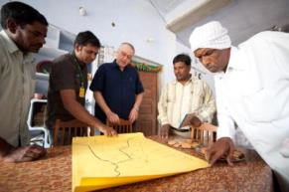
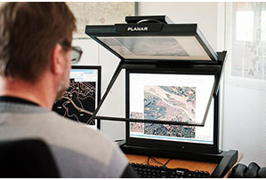
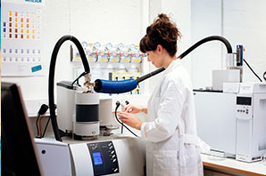
NIBIO has Leading expertise
One of the largest R&D organisations in Norway
Governmental organisation – under The Ministry of Agriculture and Food
Total staff about 680
Total turnover – approximately 80 mill Euro – with very diverse funding sources
Research stations and networks in all Norwegian regions
Extensive international collaboration
Notes:
The R&D Institute houses activities in the whole value chain; from research, to management to innovation and consulting services.
NIBIO is owned by the Norwegian Ministry of Agriculture and Food as an administrative agency with special authorization and its own board. The main office is located at Ås. The Institute has several regional divisions and a branch office in Oslo.

Slide 4
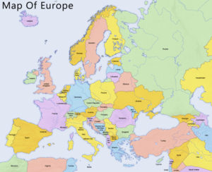
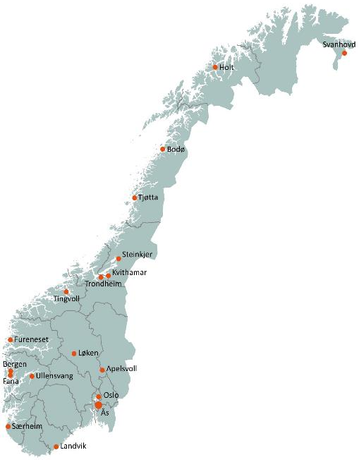
Nibio has research facilities covering large gradients in climate and agro-ecological conditions in the whole country.
In total 18 sites.

Slide 5
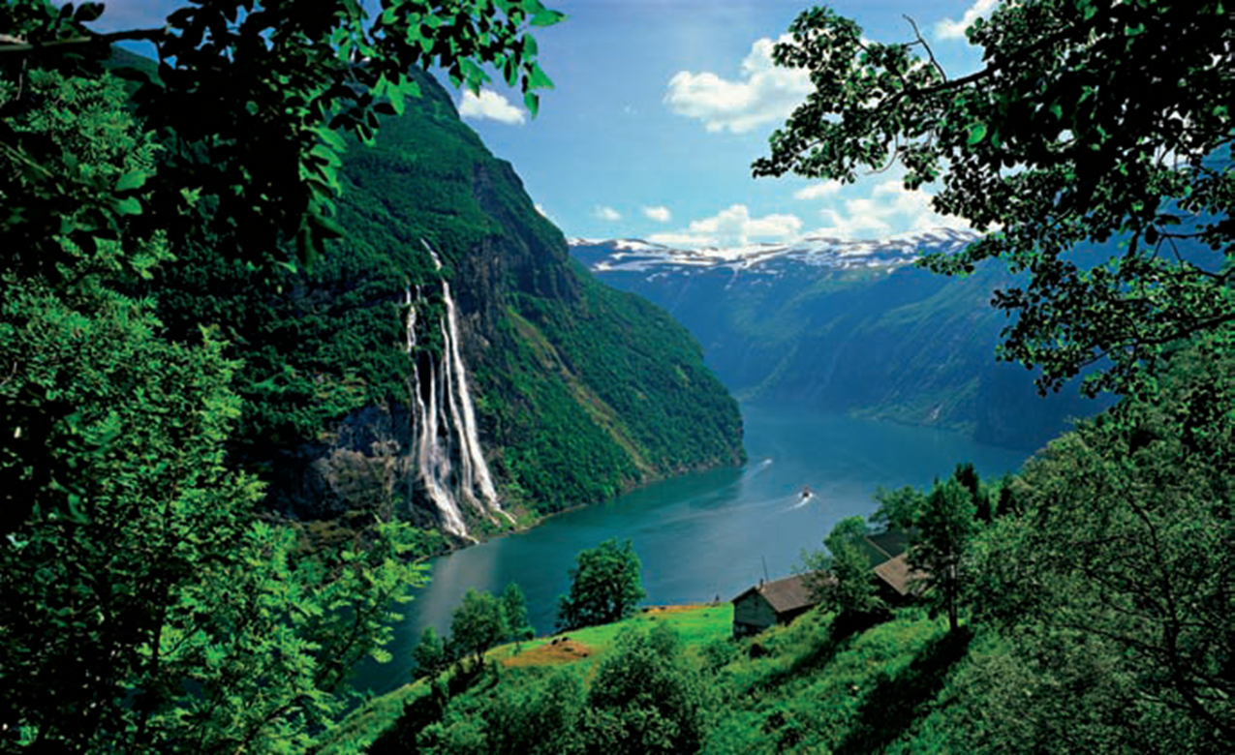
Key Thematical Areas
Geography and statistics
Environment and natural resources
Biotechnology and plant health
Forestry and forest resources
Food production and society

Slide 6
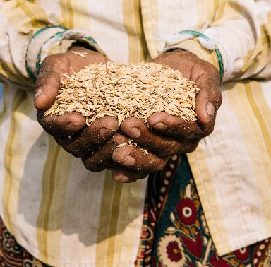
NIBIO INTERNATIONALLY
Norway is a small country, but our research is important on a global scale.
NIBIO coordinates several large EU-projects
Substantial research programmes in Asia
Development in Africa
Projects in South-America
Cross-boundary collaboration in the Barents Region
Notes:
Climate Smart Agriculture (India, China, Bangladesh, Vietnam. Startup Myanmar)
NIBIO is in the process of establishing networks and research programmes in several African countries.
The basis of bioeconomics is the utilisation and management of fresh photosynthesis, rather than a fossile economy based on preserved photosynthesis (oil).
NIBIO aims to become the leading national R&D institute for development of knowledge within the field of bioeconomy. The goal of the Institute is to contribute to food security, sustainable resource management, innovation and value creation through research and knowledge production within food, forestry and other biobased industries. The Institute delivers research, managerial support and knowledge for use in national preparedness, as well as for businesses and the society at large.

Slide 7
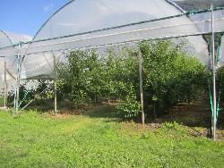
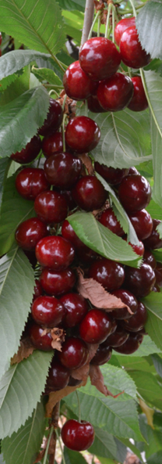
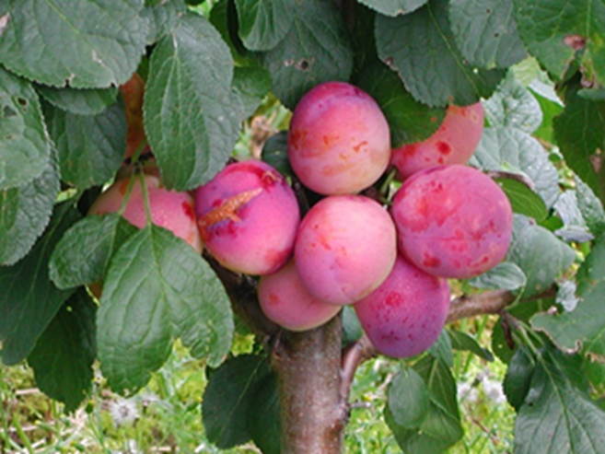
Division - FOOD PRODUCTION and society
Food safety and security
Innovation in the entire value chain
Environment and climate-smart agriculture and food production
Plant production, agronomy, soil sciences, ecology
Economy and social sciences
Cultural landscapes
Notes:
Ensure access to enough nutritious and safe food based on national resources
Produce more food at the same time as decreasing the impact food production has on the environment and available resources.
The population is increasing, both in Norway and in the world at large.
The goal is to increase food production by 30-50% by 2030.
How do we increase food production without harming the environment?

Slide 8
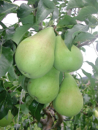
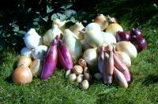
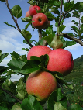
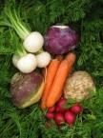
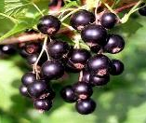
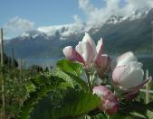
Department of Horticultrure
Working areas:
Conventional and organic production of following of crops:
Fruit and small fruit, Vegetables, Potato, Green house production
Genetic resources and analyses
Variety and rootstock testing
Crop management
Post harvest physiology: Expand the sales season
Innovation – products developments

Slide 9
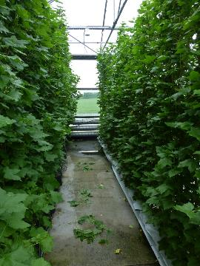
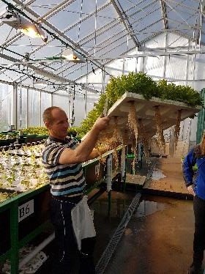
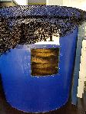
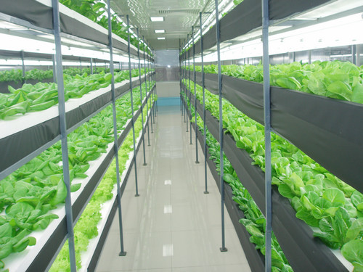
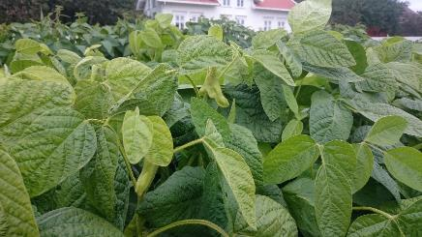
New innovations in horticulture
Aquaponics, fish and salad
Black currants in green house. June 5
Out of season Raspberry ‘ in greenhouse. Hedge, 3.5 m of ‘Tulameen’. May 29
Edamame – soyabeans harvested
as fresh vegetables
Plantfabric, resirkulating
of energy and nutrition

Slide 10
New innovations
The Norwegian pear cultivar ‘Celina’
Cross: Broket July ( Coloree de Julliet x Williams).
Brand name: QTee®. Breeder: Graminor AS, Norway
Genetic analysis.
Pollination and fruit set
High density plantings
Harvest windows, storage and fruit quality

Slide 11
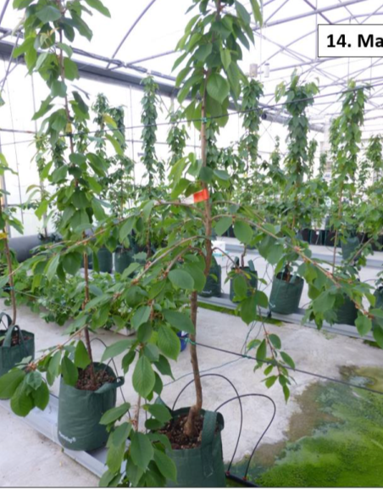
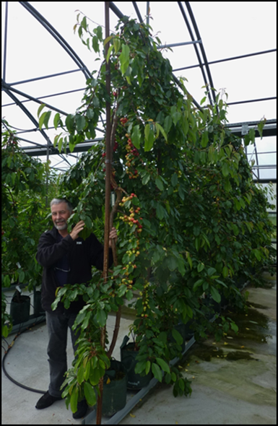
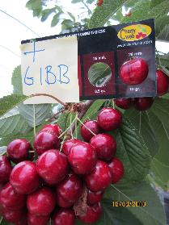
High tunnels and Green house production of sweet cherry

Slide 12
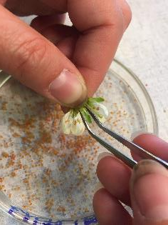
fruit set in European plum
Background: Norwegian plum acreage is increasing, but total production not proportional
Aim: Large and stable fruit set
Survey – management at plum growers
Phenology, different cultivars and regions
Controlled crossings, main cultivars and
different fathers
Pollen germination, pollen tube growth,
fertilization, EPP
Paternity testing, SSR analysis

Slide 13
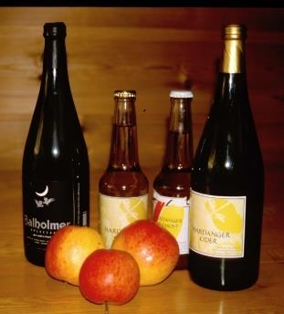
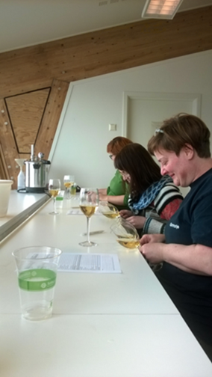
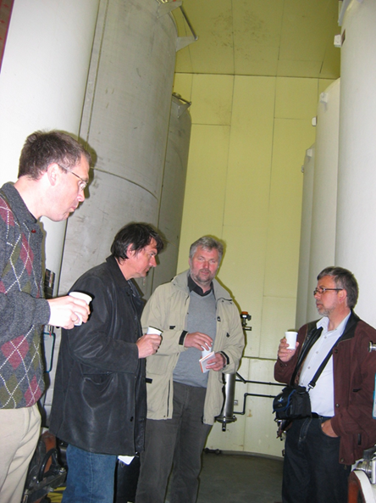
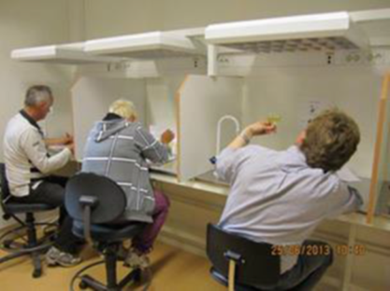
Apple cider
New goverment regulation: Farmers are allowed to sell
alkcohol >4.7 % from the farm gate
Nibo is doing product development; blending, fermenting, tasting etc
All photos : E. Vangdal

Slide 14
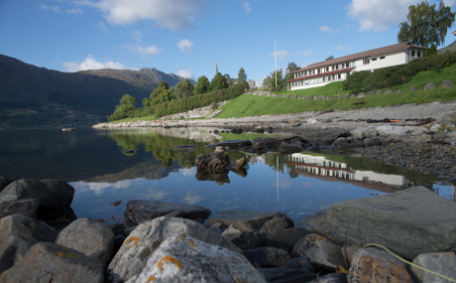
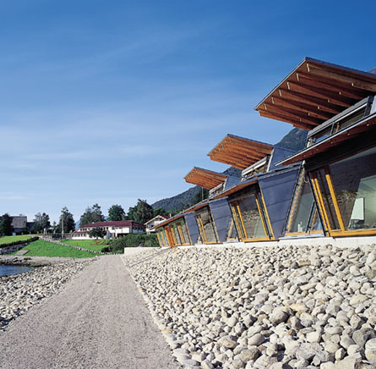
Thank you for your attention
NIBIO Ullensvang
Norway
*

