Slide 1
25th EUFRIN Board meeting 15 November 2017 Brussels, Belgium
Country report - Poland
Krzysztof Rutkowski
Research Institute of Horticulture
Department of Fruit and Vegetables Storage and Processing
email: Krzysztof.Rutkowski@inhort.pl

Slide 2
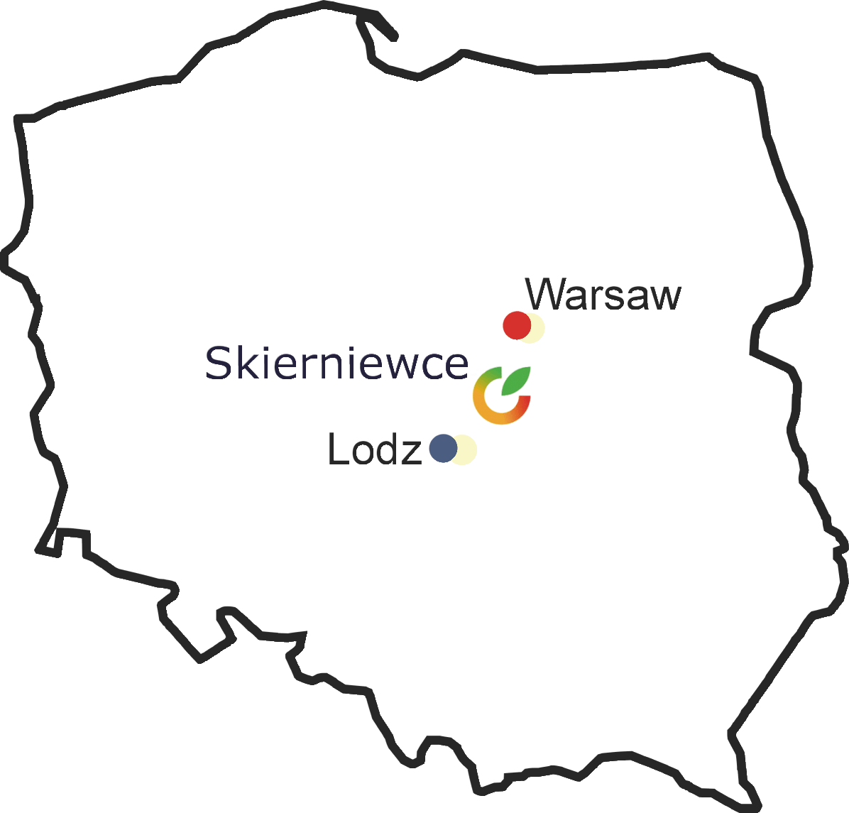
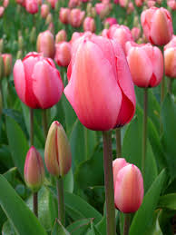
RESEARCH INSTITUTE OF HORTICULTURE
SKIERNIEWICE,POLAND
Prof. dr. Malgorzata Korbin
www.inhort.pl; io@inhort.pl

Slide 3
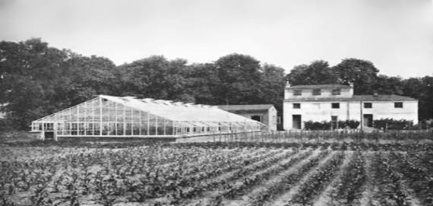
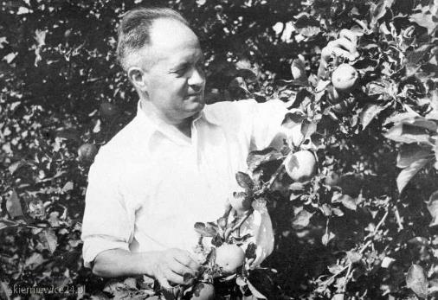
RESEARCH INSTITUTE OF HORTICULTURE
THE HISTORY AND CURRENT SITUATION
1951 – Institute of Pomology & Flor.
1964 – Institute of Vegetable Crops
2011 – Institute of Horticulture

Slide 4
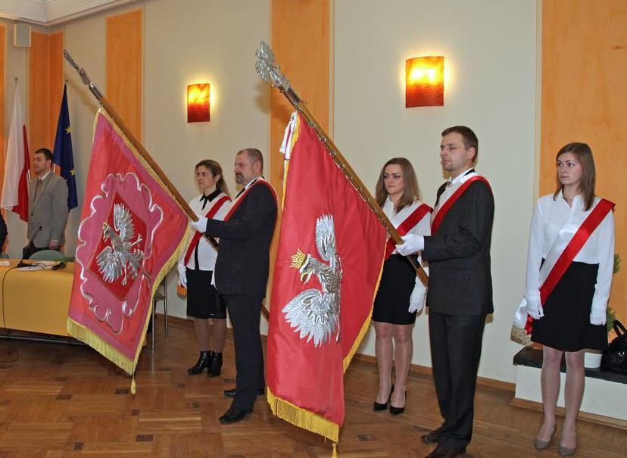
STAFF: 135 SCIENTISTS AND PHD STUDENTS PERMISSION: PhD DEGREE & SCI. TITLE (agr. sciences)

Slide 5
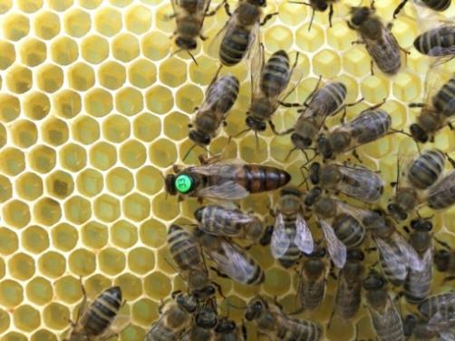
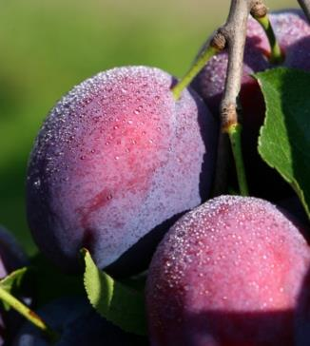
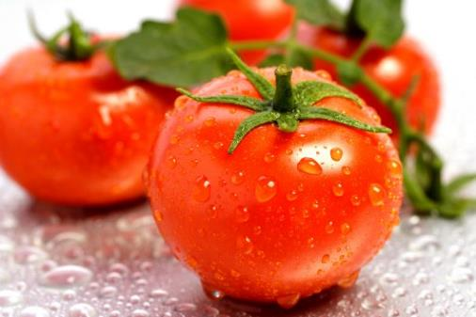
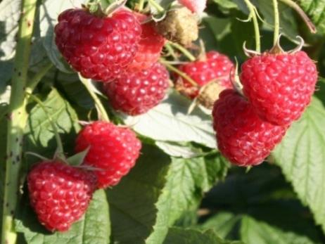
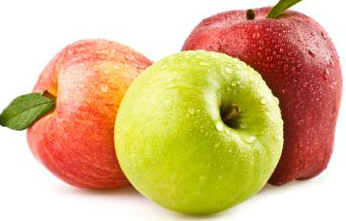
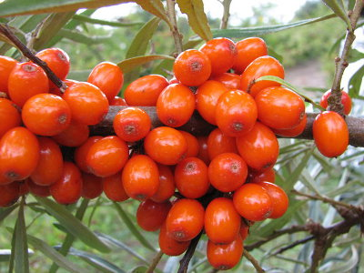
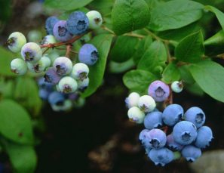
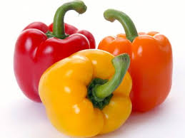
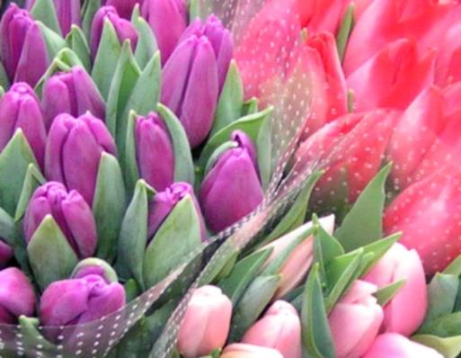
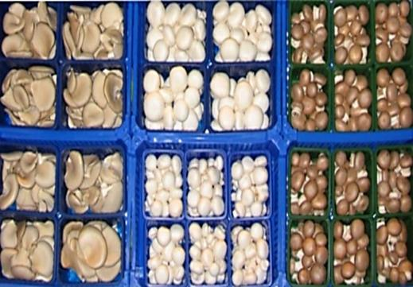
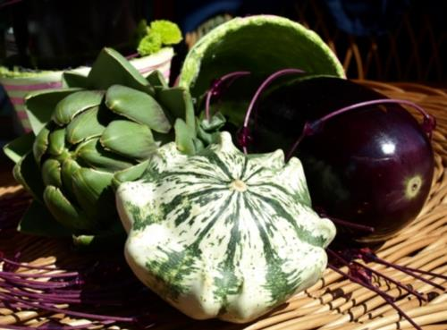

Slide 6
SCIENTIFIC AREAS
Genetic resources, genetics & breeding of horticultural plants
Sustainable plant cultivation (fertigation, irrigation)
Methods for plant protection (IPM, ecology)
Organic production of horticultural plants
Biotechnology & molecular biology
Fruit & vegetable quality and safety
Storage, postharvest treatment and processing
Agro-engineering
Mushroom production
Apiculture
Basic economy

Slide 7
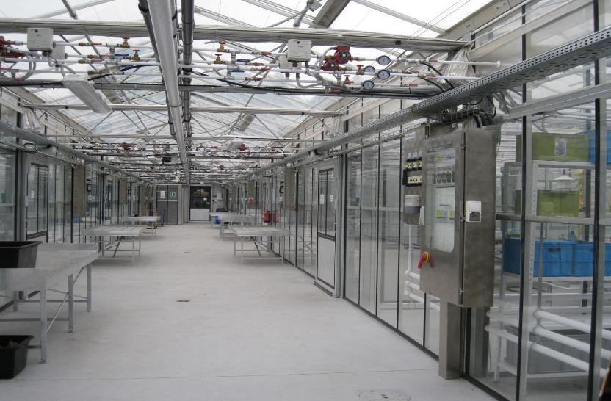
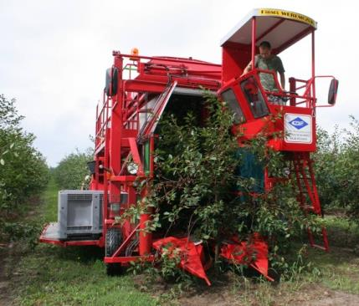
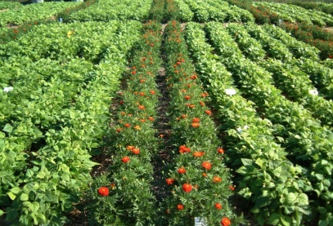
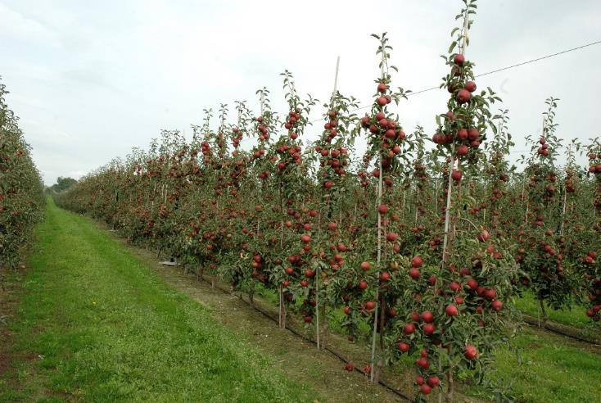
EXPER. FIELDS (165 ha) UNDER COVER (~2 ha)

Slide 8
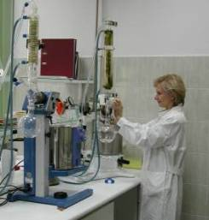
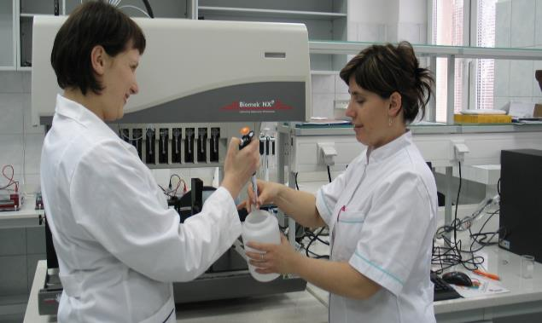
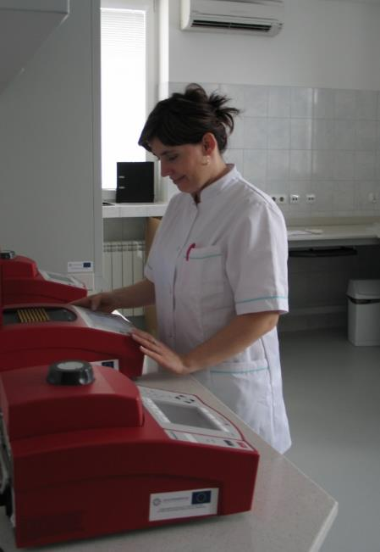
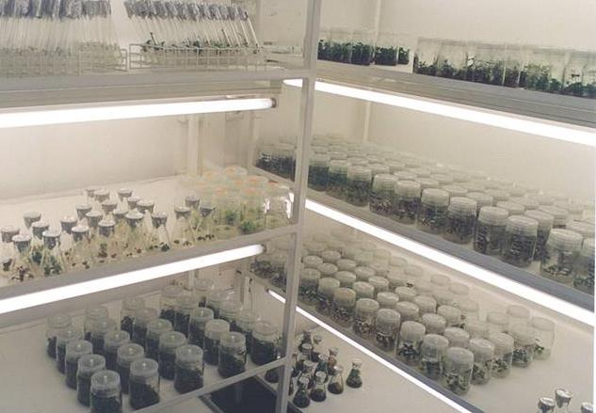
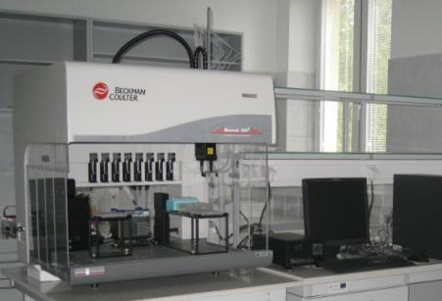
LABORATORIES (33 labs) - accredited: Food quality & safety; honey quality - labs for study on effectiveness of chemicals used for plant protection (admin. permission) - biotech & molecular labs - chemical contamination labs

Slide 9
NATIONAL & INTERNATIONAL PROJECTS
5th, 6th & 7th FP
(HiDRAS before accession)
running international: 12 Horizon 2020 (2 + 8 eval.)
COST, LIFE, DG AGRI …
2 Programs of Min. Agr.
others national projects: 60
Min. Sci.; basic budget
Project No. (%) | 2011 | 2012 | 2013 | 2014 | 2015/7
R R & D | 50 50 | 47 53 | 41 59 | 30 70 | 17-15 83
Notes:
udget

Slide 10
THE OTHER FORMS OF COOPERATION AT THE NATIONAL & INTERNATIONAL LEVELS
EUFRIN - European Fruit Research Institute Network
European Technology Platform „Food for Life”
EUCARPIA – Europ. Ass. for Research on Plant Breeding
EFSA – European Food Safety Authority
EURONION – European Onion Association
APIMONDIA – Intern. Federation of Beekeepers' Ass.
APISLAVIA - Federation of Beekeeping Organizations
KIC – Food4Future
CLASTERS: HIGH QUALITY OF FOOD, HEALTHY LIFE
EURISCO - European catalogue of plant collections
ISHS – International Society for Hort. Sciences

Slide 11
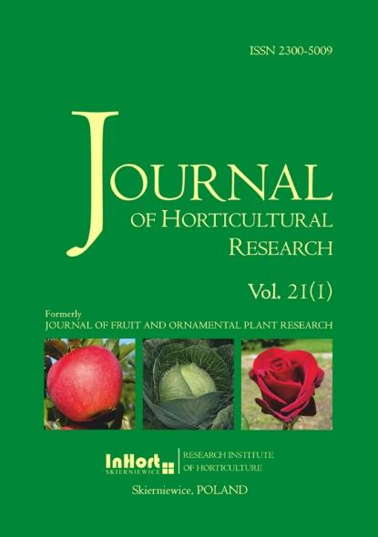
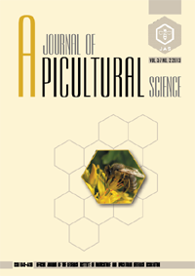
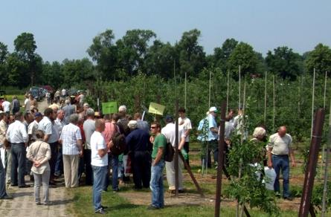
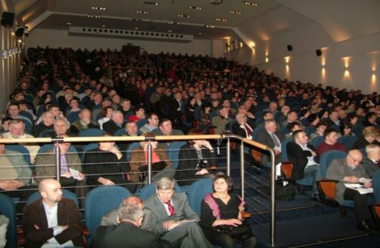
SCIENCE, APPLICTION & DISSEMINATION 3 journals, 6000 consult., 2000 visits, ~20 conferences

Slide 12
ACTIVITY FOR THE SECTOR NATIONAL ADMINISTRATIONS (MRiRW, GIORiN, IJHARS, extension services)
PERMAN.
regular trainings
food safety
TEMPORAR.
scientific exchange
plant protection (methodology for IPM, programs)
gene bank/ core collection
expertises (embargo, natural threats, neonicotinoids)
new markets (fitosanitary doc., Pest Risk Analysis)

Slide 13
PLATFORM FOR TECHNOLOGICAL INNOVATIONS IN HORTICULTURE (2015)
InHort
(18 sci. Units)
the industry
producers’ groups
innovations
innovations
requirement
requirement
DISSCEMINATION

Slide 14
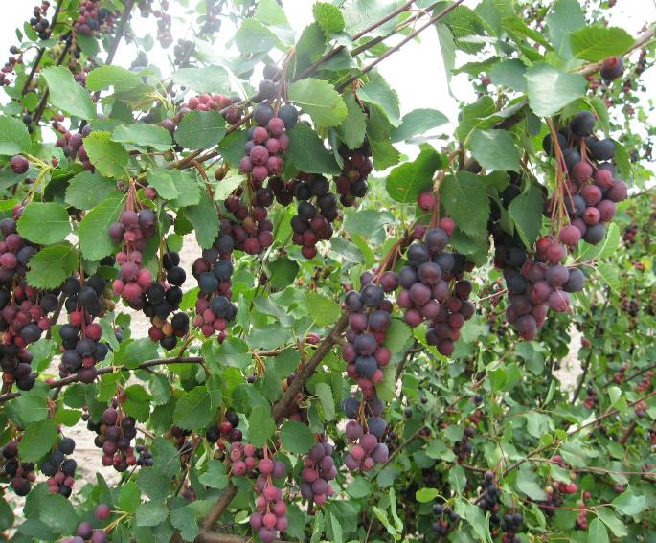
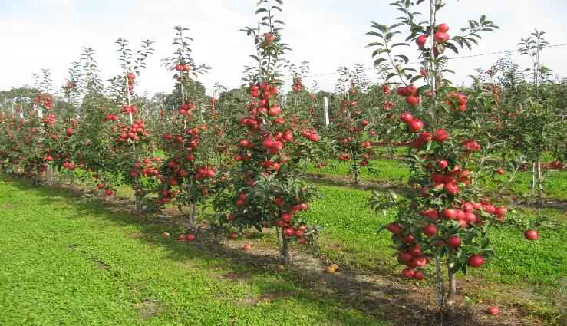
EXAMPLES: NEW CULTIVARS AND UNKNOWN SPP.
‘LIGOLINA’ – NEW POLISH CULTIVAR OF APPLE
(200 cvs in Polish National/ Intern. Registers – apple, strawberry, raspberry, blackcurrant, rootstocks, cherry, cucumber, cabbage ….)
„NEW” SPECIES – AMELANCHIER spp.
Notes:
_

Slide 15
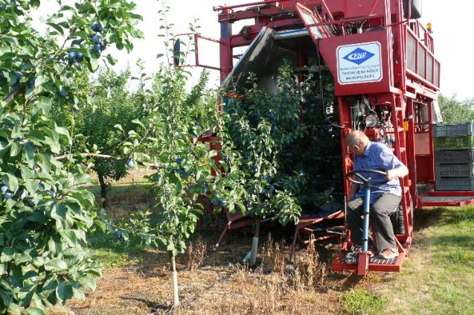
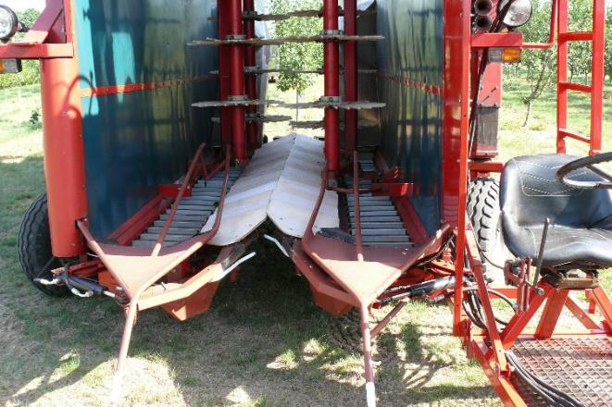
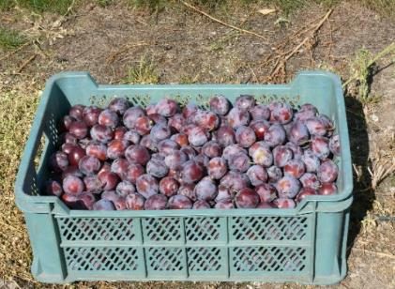
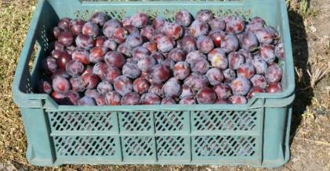
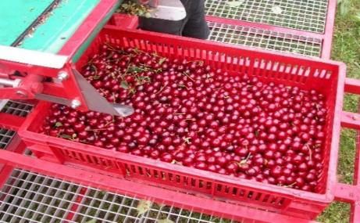
AGRO-ENGINEERING
News at the world level (mechanical harvesting)
Efficiency 0,2 ha/h
Efficiency improving 50 x > manual

Slide 16
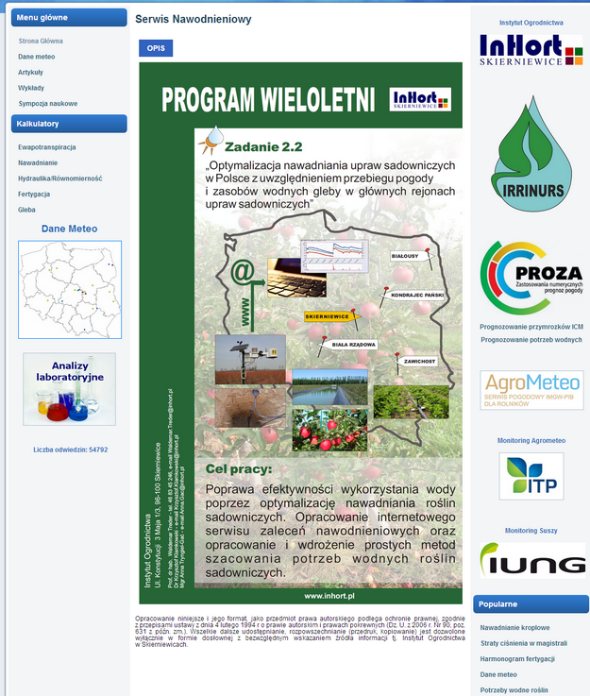
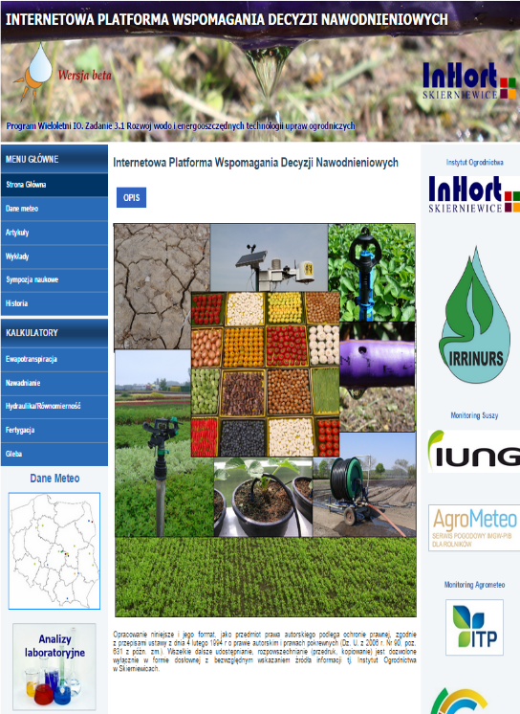
IRRIGATION SERWIS (www.nawadnianie.inhort.pl) INTERNET PLATFORM

Slide 17
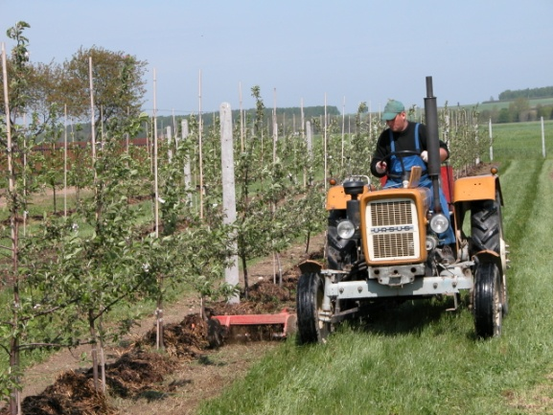
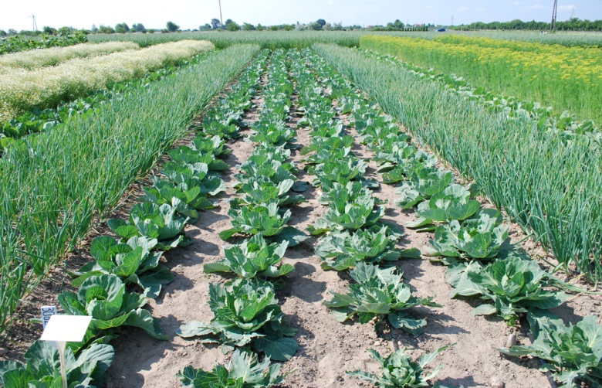
ECOLOGICAL ORCHARD & FIELDS
10 ha
multi-level study: cultivars & rootstock choice, prevention & protection against pests and diseases, beneficial organisms etc.

Slide 18
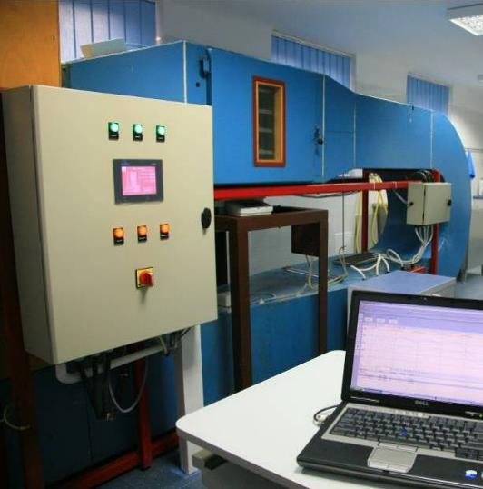
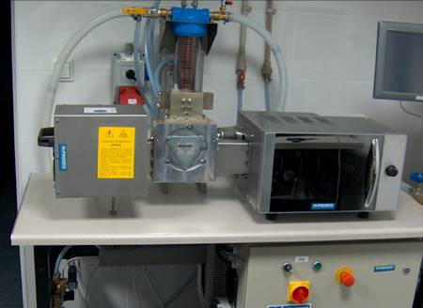
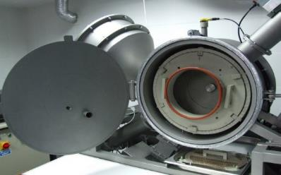
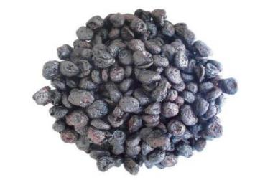
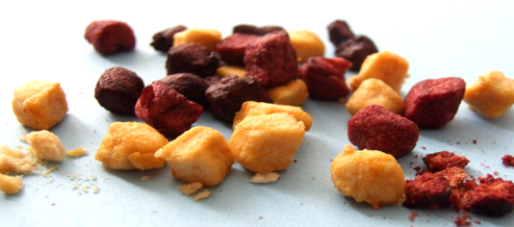
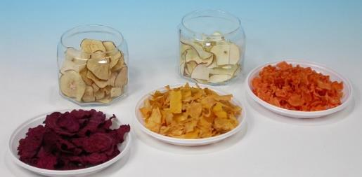
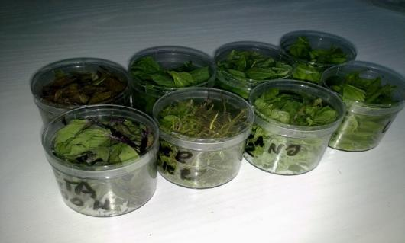
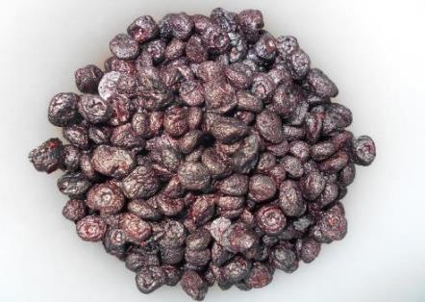
INNOVATION IN PRECESSING

Slide 19
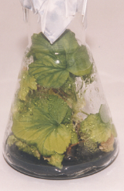
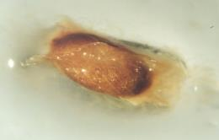
MOLECULAR BIOLOGY & BIOTECH. IN HORTICULTURE

Slide 20
FRUIT PRODUCTION IN POLAND

Slide 21
Fruit production (in thousands tons) - apples

Slide 22
Fruit production (in thousands tons) - pears

Slide 23
Fruit production (in thousands tons) - plums

Slide 24
Fruit production (in thousands tons) – sour cherries

Slide 25
Fruit production (in thousands tons) – sweet cherries

Slide 26
Fruit production (in thousands tons) - peaches

Slide 27
Fruit production (in thousands tons) - strawberries

Slide 28
Fruit production (in thousands tons) - raspberries

Slide 29
Fruit production (in thousands tons) - black currant

Slide 30
Fruit production (in thousands tons) - blueberries

Slide 31
CONFERENCES

Slide 32
CAMA 2017

Slide 33
CAMA 2017

Slide 34
Next Conference in Skierniewice in 2018 ?
4th International Conference
Effect of Pre- and Post-harvest Factors on Health Promoting Components and Quality of Horticultural Commodities

Slide 35
Next Conference in Skierniewice in 2018 ?

Slide 36
Thank you
Krzysztof.Rutkowski@inhort.pl

