Slide 1
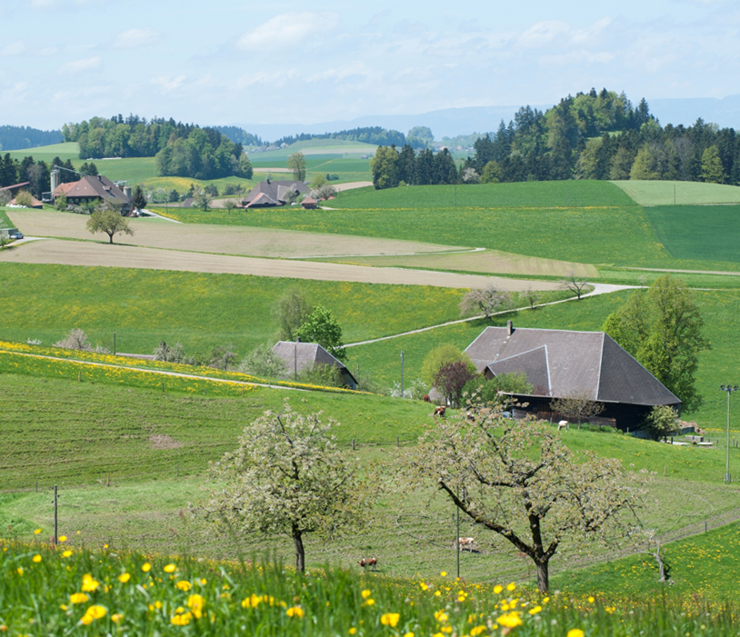
Agroscope
good food, healthy environment
Andreas Naef
EUFRIN Board Meeting
Brussels, 15 November 2017

Slide 2
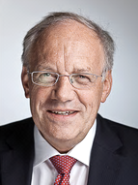
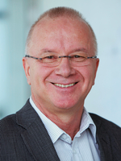
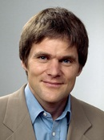
Agroscope within the EAER
EAER
Federal Depart-
ment of Economic
Affairs, Education
and Research
ETH
Swiss Federal Institute of Technology
FOAG
Federal Office for
Agriculture
SECO
State Secretariat for Economic Affairs
SERI
State Secretariat for Education, Research and Innovation
FONES
Federal Office for National Economic Supply
FOH
Federal Office for Housing
Agroscope Council
Agroscope
3 Competence
Divisons
7 Strategic
Research
Divisions
Resources

Slide 3
Key Figures 2016
  911 people were employed by Agroscope,
  of whom 411 (44%) were women
  65 trainees
  ______
  1217 publications
  2155 lectures at universities and technical colleges
  ______
  14,6 million Swiss francs of third-party funding for research

Slide 4
Organisational Logic
Agroscope Management
Farmers
Universities
Competence Division for Research Technology and Knowledge Exchange
(CD)
Strategic Research Division (RD)
Business
Research Institutes
Extension / Legal-Enforcement Agencies
Scientific Community
Strengthening the cooperation through interconnections between entities with different focuses
Better orientation towards the different stakeholder groups

Slide 5
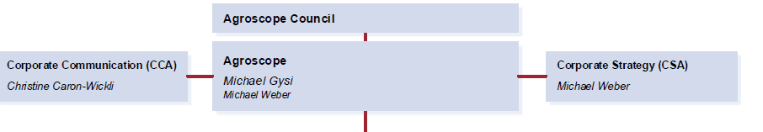
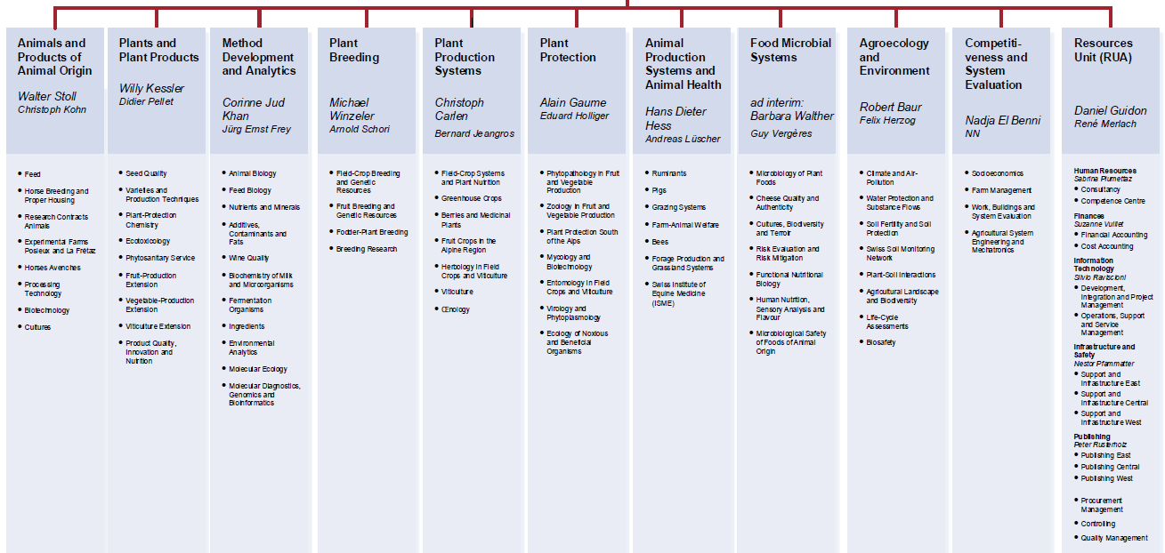
Organization of Agroscope since 1.1.2017
Phytopathology and Zoology in Fruit and Vegetable Production
Competence Divisions
Strategic Research Divisions

Slide 6

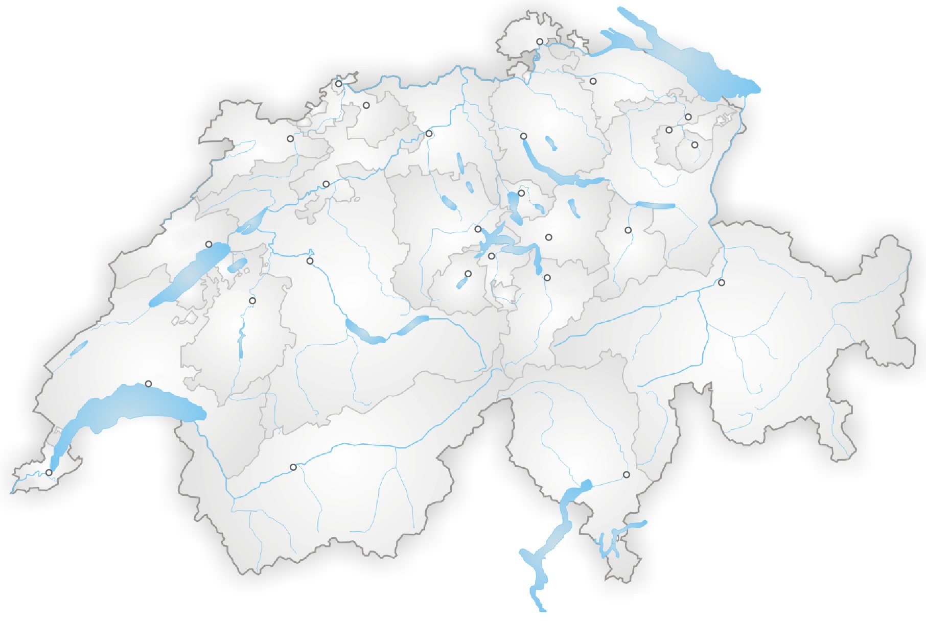

Standorte mit Obstbauforschung
^{Schaffhausen}
Experimental Farm
(Coop. with Canton Thurgau)
Ellighausen
Güttingen
^{Basel}
Wintersingen / Breitenhof
Tänikon
^{Frauenfeld}
^{Liestal}
Experimental Farm
^{St. Gallen}
^{Delémont}
^{Aarau}
Reckenholz
^{Zürich}
^{Herisau}
Stäfa
^{Appenzell}
^{Solothurn}
Oensingen
Wädenswil
Le Noirmont / Les Bois
^{Zug}
Fruit-Production Extension
Phytopathologie and Zoology
Fruit breeding & genetic ressources
Produktequalität (storage, sensory, microbiology)
Phytosanitary Service
Experimental Farm
^{Neuchâtel}
^{Luzern}
^{Schwyz}
^{Glarus}
Liebefeld
^{Bern}
^{Sarnen}
^{Stans}
Bullet / La Frétaz
Avenches
^{Altdorf}
^{Chur}
^{Fribourg}
Arosa
Châtonnaye
Posieux
Goumoens
Mycology & Biotechnology
Entomology in Field Crops and Viticulture
^{Lausanne}
Pully
Nyon, Changins
Conthey
^{Sion}
Chamoson
Cugnasco
^{Bellinzona}
^{Genève}
Leytron
Fruit Crops in the Alpine Region (apricots, irrigation)
Berries and Medical Plants
Experimental Farm Conthey
>Gudo
Basse-Nendaz / Coor
Cadenazzo
Bruson
Standorte
Aussenstandorte
Betriebe

Slide 7
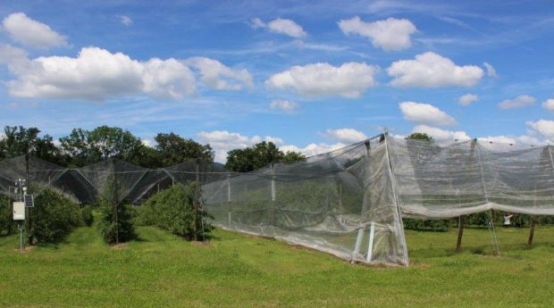
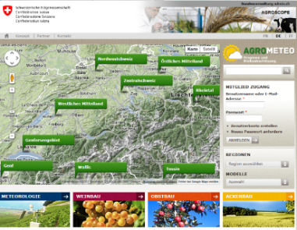
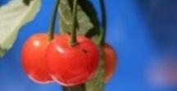
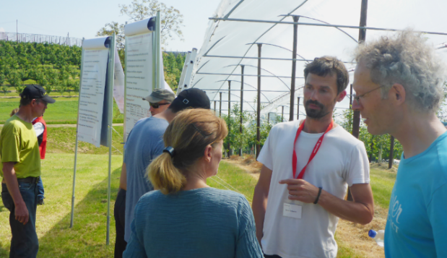
Research Fruit-Production Extension
Head: Andreas Naef
Research & Development
Exchange with Fruit sector through a «Fruit Forum»
Practice-oriented research and development in plant protection, production systems, varieties, economy
Decision support systems and knowledge transfer
Third party funding
Herakles Plus: fire blight, Marssonina coronaria
fenaco-collaboration: control of storage diseases
Interreg: Model orchards for integrated crop protection
Interreg: weed control in fruit production
Task Force SWD – Module stone fruits
EUFRUIT– The European Fruit Network
Support of Federal Office for Agriculture
Reports on efficacy and application of plant protection products in fruit production
Expertise for FOAG

Slide 8
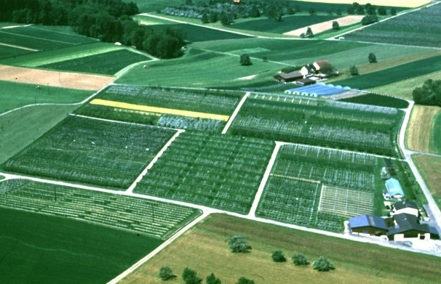
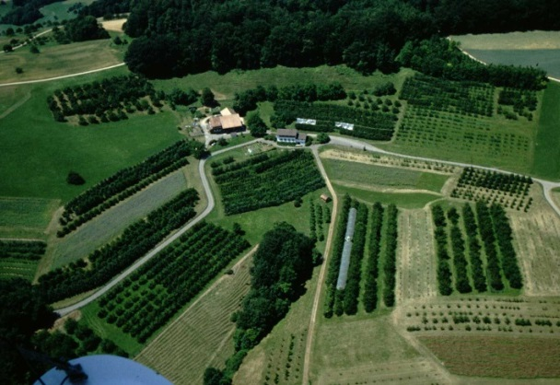
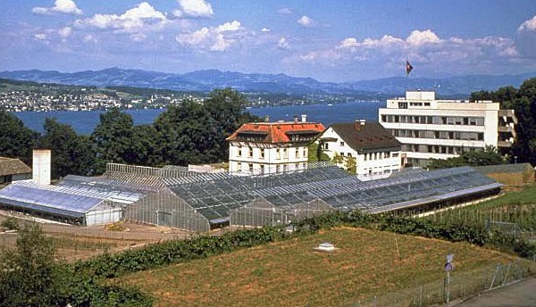
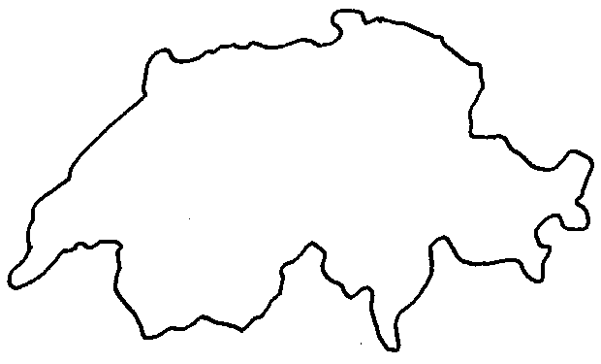
Our experimental farms
Güttingen (8.4 ha)
Pome and stone fruits
Partnership with
LBBZ Arenenberg
Breitenhof (9 ha)
Stone fruit centre
Partnership with Cantons,
SOV and FiBL
Wädenswil (22.5 ha)
Pome and stone fruits
Apple breeding
Nuclear stock

Slide 9
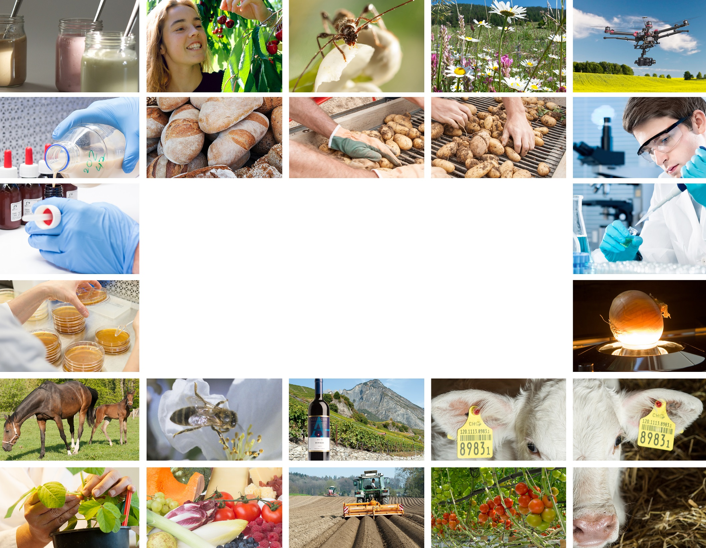
Thank you for your attention
Andreas Naef
andreas.naef@agroscope.admin.ch
Agroscope good food, healthy environment
www.agroscope.admin.ch

